Slide 1

Time series forecast XGBoost TS – Hybrid solution. Auto Framework. Determining Optimal Lags for XGBoost Your Name: Guy Yarhi Cycle: DS17 2024

Slide 2
AGENDA
Introduction
Workflow and Execution
Architecture
Data Exploration
Development Environment
System –Flow Diagram
Summary

Slide 3
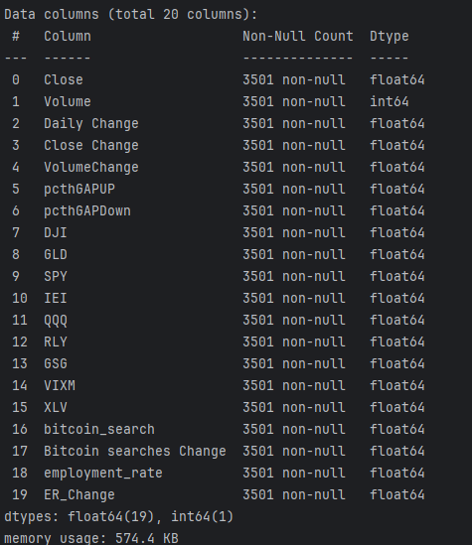
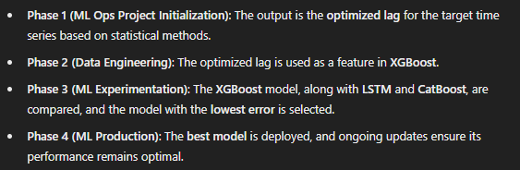
Introduction
DatetimeIndex: 3501 entries, 2014-10-01 to 2024-05-01

Slide 4
Overview:
Introduction to the time series modeling approach
Why XGBoost is chosen for time series data
High-level explanation of the architecture and process flow

Slide 5
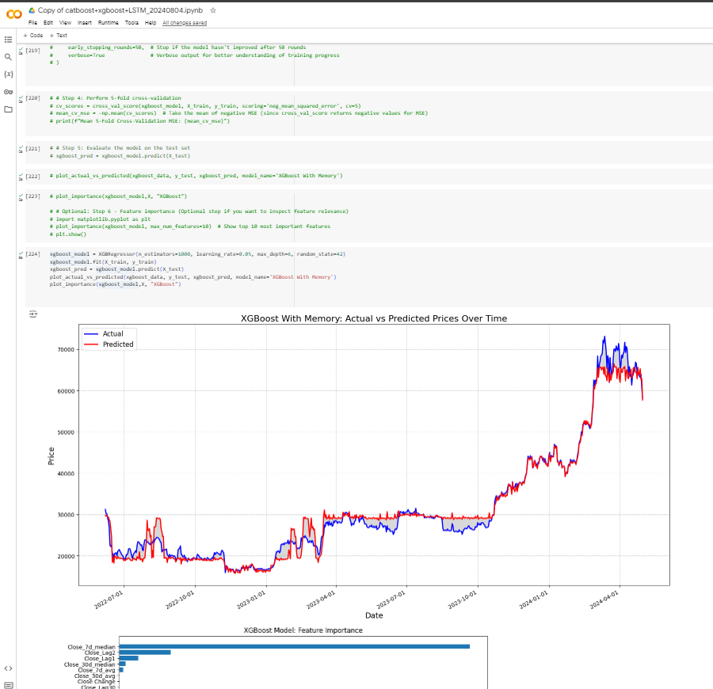
google research Colab
Workflow and Execution

Slide 6
Problem Definition:
You’re working on a time series forecasting problem where the goal is to predict future values based on past observations. This could be anything from stock prices.
Importance of capturing lagged relationships
Key challenge:
Define the Range of Lags: Decide on a range of lag values to test, e.g., 1 to 10 previous time steps. -Done
Create Lagged Features: For each lag value, create new features in your dataset representing the values at those previous time steps. Done
Forecast Automated Framework: Holistic solution in the spirit of the COLAB research. the improvements specialized in feature engineering keep OOP principles(PyCharm). Done
Amazon Bedrock cloud Implementation based on the Holistic solution developed by PyCharm. To do
Workflow and Execution

Slide 7
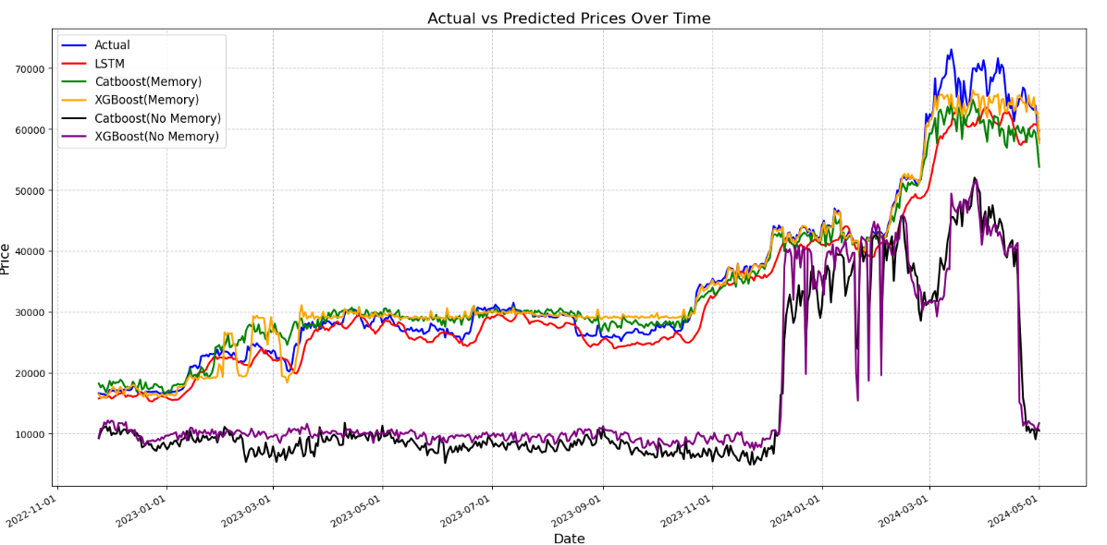
Models RESULT
DatetimeIndex: 3501 entries, 214-10-01 to 2024-05-01
Workflow and Execution

Slide 8
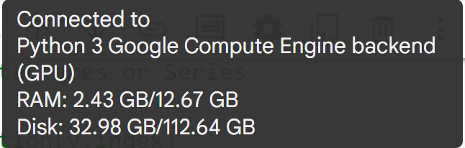
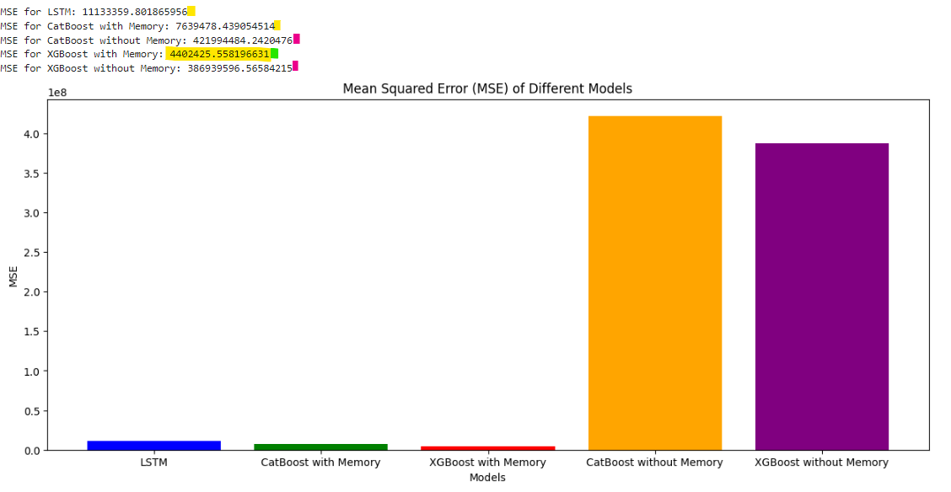
Algorithms Comparison
Workflow and Execution

Slide 9
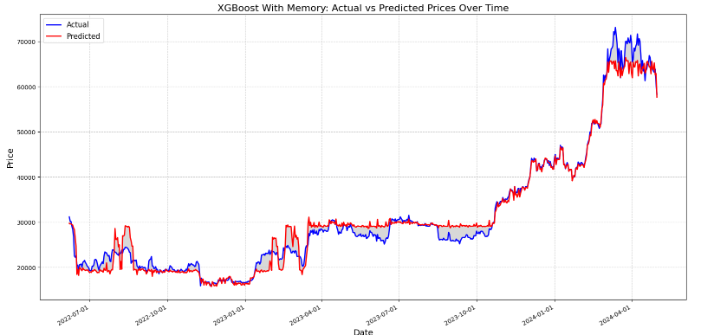
Best Result Model – Manual Lag
Workflow and Execution

Slide 10
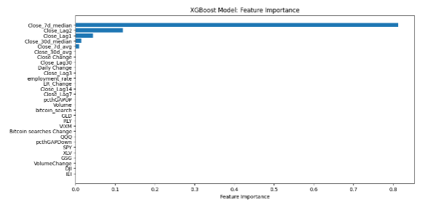
Best Result Model
Workflow and Execution

Slide 11
Data Exploration

Slide 12

Data Flow
Data Flow:
Input Data → Feature Engineering → Model Selection → Model Training → Model Evaluation
Focus on Feature Engineering:
Transform time series into supervised learning by adding lagged variables.
Architecture

Slide 13
Data Exploration.
In time series analysis, including all data points except NaNs (Not a Number) is crucial for several reasons:
Noise Contribution: Including all data captures natural variability, essential for robust forecasting.
Model Accuracy: Ensures models learn from the full range of data variability, avoiding bias.
Handling NaNs
Interpolation: Fill missing values using methods like linear or spline interpolation.
Imputation: Replace NaNs with statistical measures like mean or median.
Forward/Backward Filling: Use the last or next observed value to fill NaNs.
Key Takeaways
Noise is Valuable: Provides crucial information about data variability and uncertainty.
Complete Data: Ensures more reliable and robust forecasting models.
Data Exploration

Slide 14
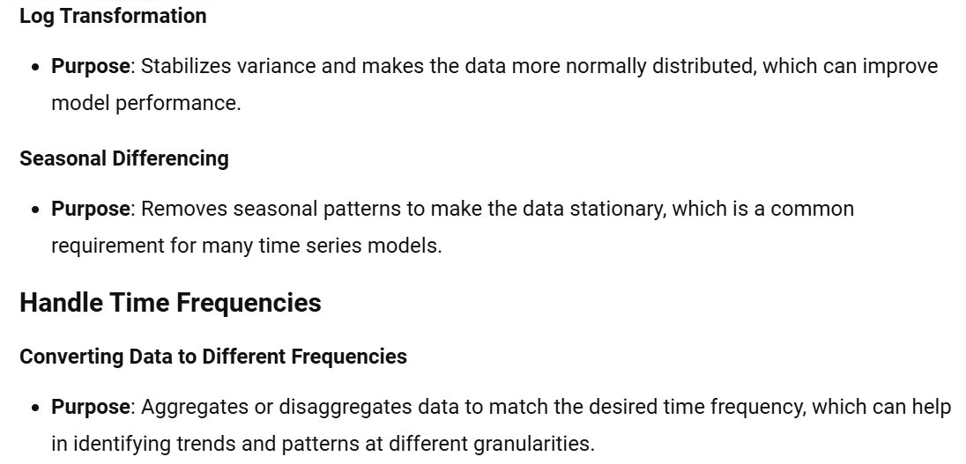
system architecture
Data transformation :
Notes:
Transformations: Apply log transformation, seasonal differencing.
Handle Time Frequencies:
Convert data to different frequencies like Yearly, Monthly, Weekly, Daily.

Slide 15
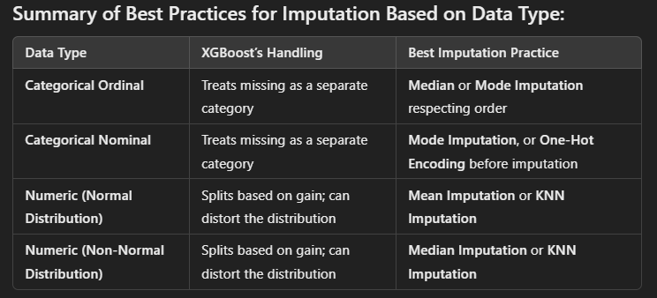
XGBoost – BESt Practice
Architecture

Slide 16
Architecture Phase 1

Slide 17

Architecture – Holistic solution
Objective:
To determine optimal lag values for building predictive models using XGBoost.
Process:
Data exploration and preprocessing
Determining the optimal lags (AR, MA, Seasonal) using SArimax
Building XGBoost model.
Evaluating model performance
Key Algorithms:
Autoregressive Integrated Moving Average (ARIMA)
XGBoost for regression tasks
Lags
XGBoost’s built-in handling of missing data may be convenient, but …
but explicit imputation techniques that take into account the type and meaning of the data
Distortion occurs when missing values are treated that are not aligned with the original data’s structure
Architecture
Notes:
Summary:
Distortion occurs when missing values are treated as separate categories in ways that are not aligned with the original data’s structure (e.g., ordinal categories, numeric distributions).
Errors arise from failing to properly impute missing values based on their context or meaning in the dataset.
XGBoost’s built-in handling of missing data may be convenient, but explicit imputation techniques that take into account the type and meaning of the data (e.g., using mean, median, or mode imputation) are often more appropriate to preserve the integrity of the dataset.

Slide 18
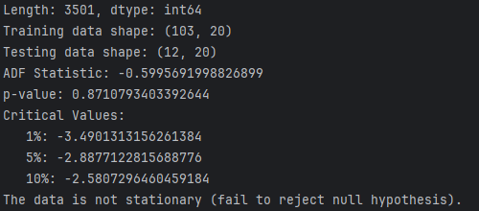
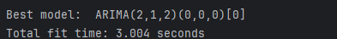
Phase 1: Arimax –Analyze time series for XGBoost lag
Expects Stationary data:
Architecture
Notes:
Summary:
Distortion occurs when missing values are treated as separate categories in ways that are not aligned with the original data’s structure (e.g., ordinal categories, numeric distributions).
Errors arise from failing to properly impute missing values based on their context or meaning in the dataset.
XGBoost’s built-in handling of missing data may be convenient, but explicit imputation techniques that take into account the type and meaning of the data (e.g., using mean, median, or mode imputation) are often more appropriate to preserve the integrity of the dataset.

Slide 19
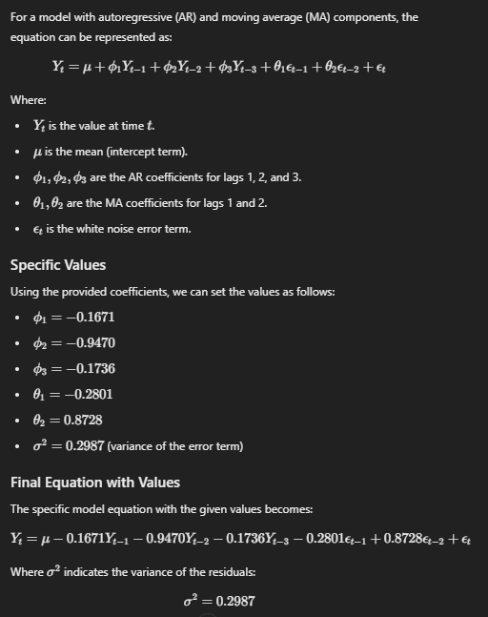
Phase 1: Arimax –Analyze time series for XGBoost lag
Architecture
Notes:
Summary:
Distortion occurs when missing values are treated as separate categories in ways that are not aligned with the original data’s structure (e.g., ordinal categories, numeric distributions).
Errors arise from failing to properly impute missing values based on their context or meaning in the dataset.
XGBoost’s built-in handling of missing data may be convenient, but explicit imputation techniques that take into account the type and meaning of the data (e.g., using mean, median, or mode imputation) are often more appropriate to preserve the integrity of the dataset.

Slide 20
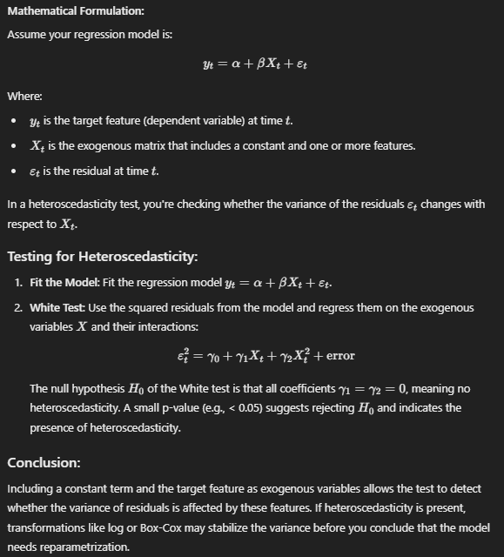
Phase 1: Arimax –Analyze time series for XGBoost lag - (Core logic)
Architecture
Notes:
Summary:
Distortion occurs when missing values are treated as separate categories in ways that are not aligned with the original data’s structure (e.g., ordinal categories, numeric distributions).
Errors arise from failing to properly impute missing values based on their context or meaning in the dataset.
XGBoost’s built-in handling of missing data may be convenient, but explicit imputation techniques that take into account the type and meaning of the data (e.g., using mean, median, or mode imputation) are often more appropriate to preserve the integrity of the dataset.

Slide 21
Phase 1: Arimax –Analyze time series for XGBoost lag
In Phase 1 (ML Ops Project Initialization), a statistical approach is employed to uncover the optimal lag for the target variable based on the relevant time periods (daily, weekly, monthly, or yearly). This lag selection process is automated, leveraging statistical techniques such as autocorrelation and cross-correlation to identify the best lag for each time granularity. The system dynamically determines the ideal lag, which is crucial for time series forecasting, ensuring that historical data points are used optimally.
Once the optimized lag is identified, it automatically feeds into Phase 2.
In Phase 2 (Data Engineering) where this optimized lag becomes a key feature for model training.
In this case, XGBoost is the primary algorithm used for predictive modeling, incorporating the optimized lag into the feature set to improve model performance.
Architecture
Notes:
Summary:
Distortion occurs when missing values are treated as separate categories in ways that are not aligned with the original data’s structure (e.g., ordinal categories, numeric distributions).
Errors arise from failing to properly impute missing values based on their context or meaning in the dataset.
XGBoost’s built-in handling of missing data may be convenient, but explicit imputation techniques that take into account the type and meaning of the data (e.g., using mean, median, or mode imputation) are often more appropriate to preserve the integrity of the dataset.

Slide 22
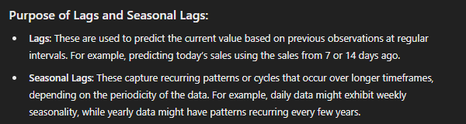
Phase 1: Arimax –Analyze time series for XGBoost lag
In Phase 2 (Data Engineering) where this optimized lag becomes a key feature for model training.
In this case, XGBoost is the primary algorithm used for predictive modeling, incorporating the optimized lag into the feature set to improve model performance.
Architecture
Notes:
Summary:
Distortion occurs when missing values are treated as separate categories in ways that are not aligned with the original data’s structure (e.g., ordinal categories, numeric distributions).
Errors arise from failing to properly impute missing values based on their context or meaning in the dataset.
XGBoost’s built-in handling of missing data may be convenient, but explicit imputation techniques that take into account the type and meaning of the data (e.g., using mean, median, or mode imputation) are often more appropriate to preserve the integrity of the dataset.

Slide 23
Architecture Phase 2

Slide 24
system architecture
Why XGBoost ?
Handles missing data:
“Efficiently” manages datasets with missing values.
Scalable:
Suitable for large datasets.
High Performance:
Often outperforms other machine learning algorithms on structured data.
Algorithm:
Gradient Boosting: Utilizes decision trees to improve model accuracy.
Do not remove outlier\Noise – TS requirement.
Key Parameters:
max_depth: Maximum depth of a tree.
n_estimators: Number of boosting rounds.
learning_rate: Step size shrinkage to prevent overfitting.
subsample: Fraction of samples used for fitting individual base learners.
Grid Search: Perform grid search to optimize these parameters.
Architecture

Slide 25
Development Environment

Slide 26
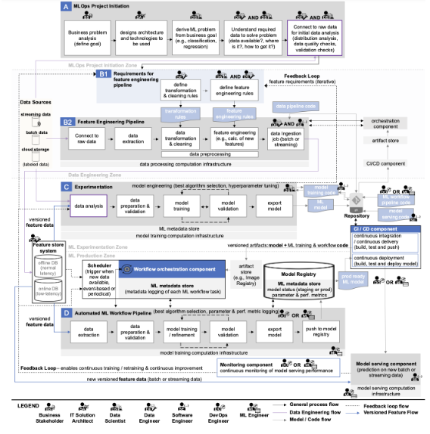
ML-DLC

Slide 27
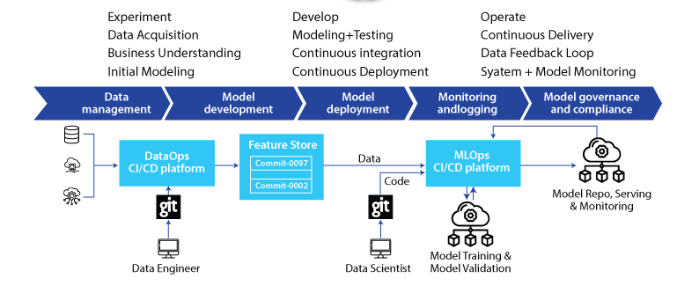
ML-DLC

Slide 28
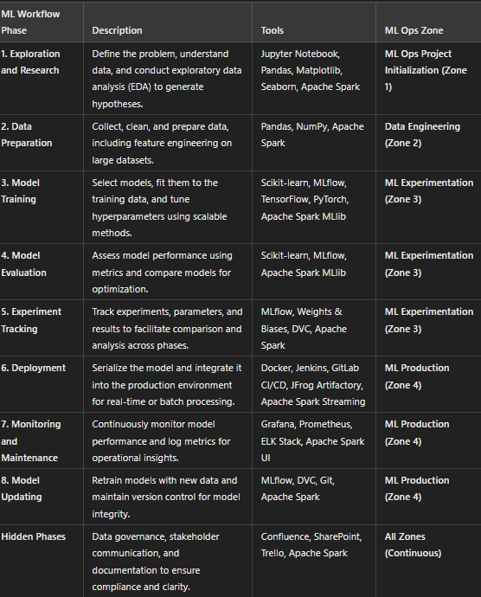
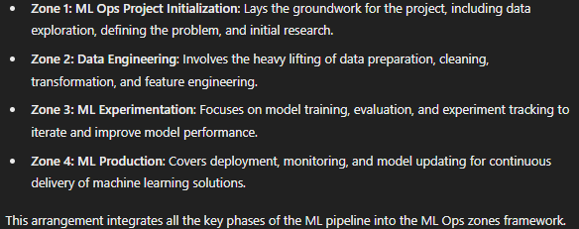
ML-DLC

Slide 29
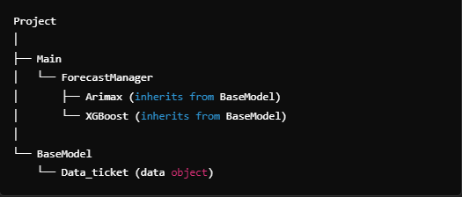
Main Class Structure

Slide 30
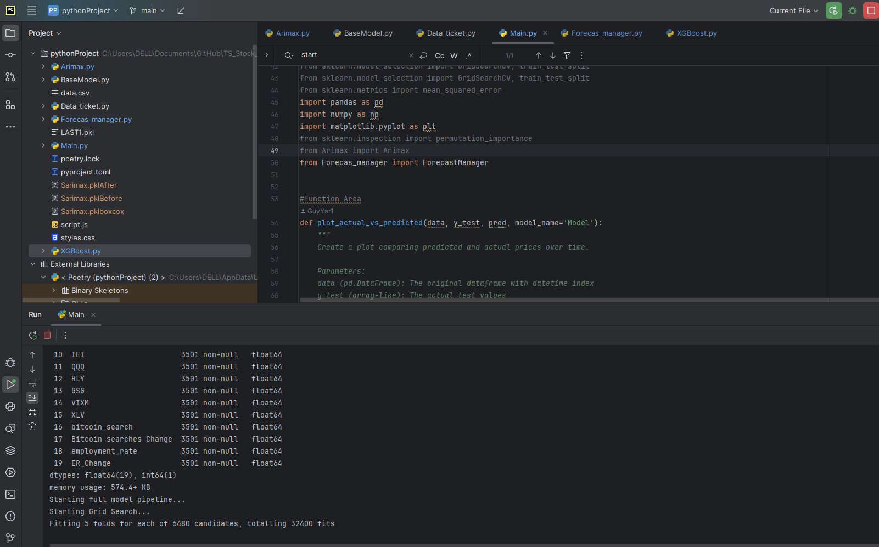
Development - IDE

Slide 31
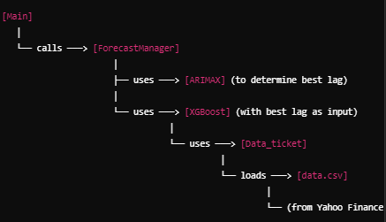

Slide 32
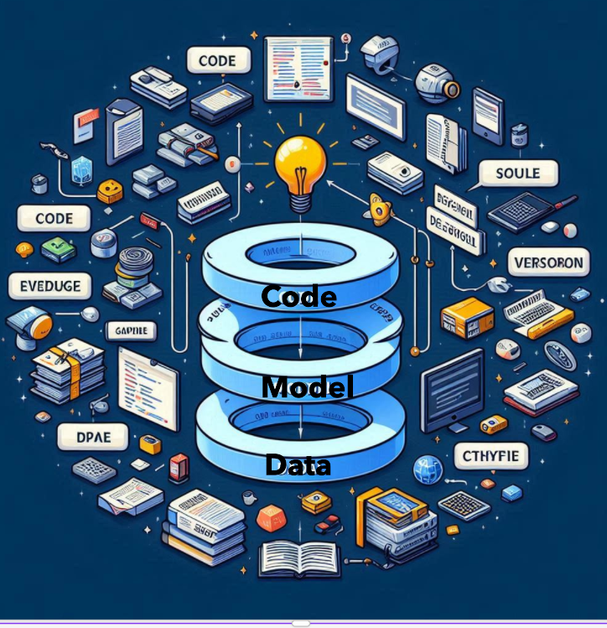
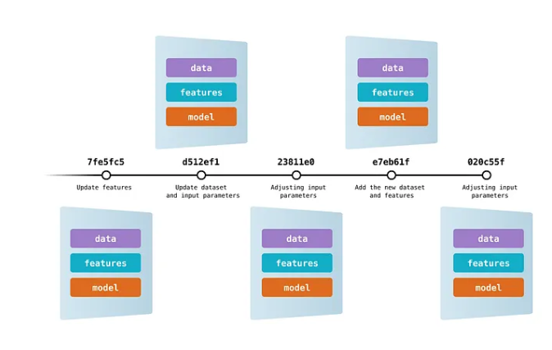
Version Repository
Code, Model, Data

Slide 33
Development Environment
Backend:
Language: Python 3.11
IDE: PyCharm 2024.1.1 (Community Edition)
Using:
Time series algorithm: Arimax, Sarimax
Adapted to time series: Xgboost
Libraries: pandas, numpy, scikit-learn, xgboost, statsmodels, matplotlib, seaborn, catboost, pmdarima, torch, joblib, scipy
Utilities: GridSearchCV. (machine learning hyperparameter tuning)
Dependency management and package management:
Poetry version 1.8.3
Source control:
git - version 2.40.1.windows.1
GitHub Desktop - Version 3.4.5 (x64)

Slide 34
Summary

Slide 35
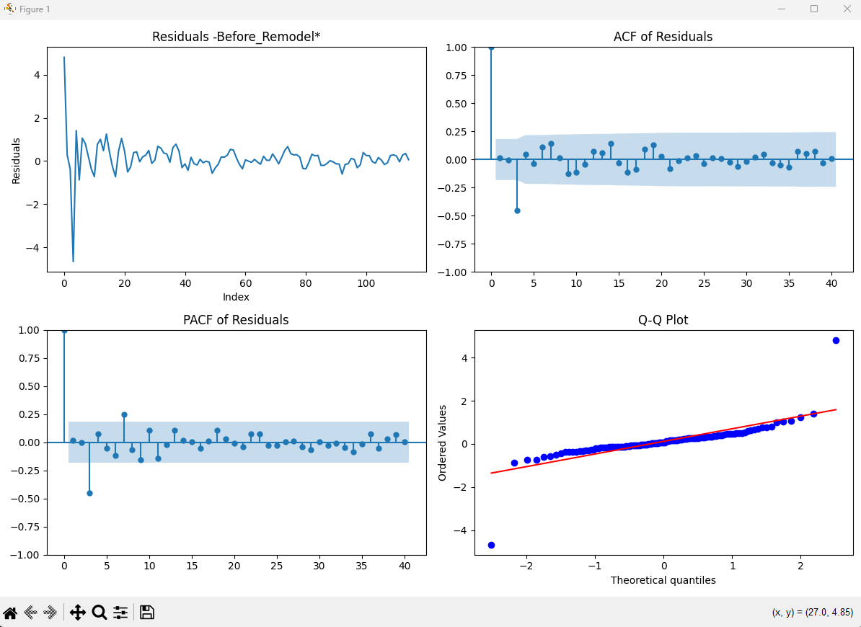
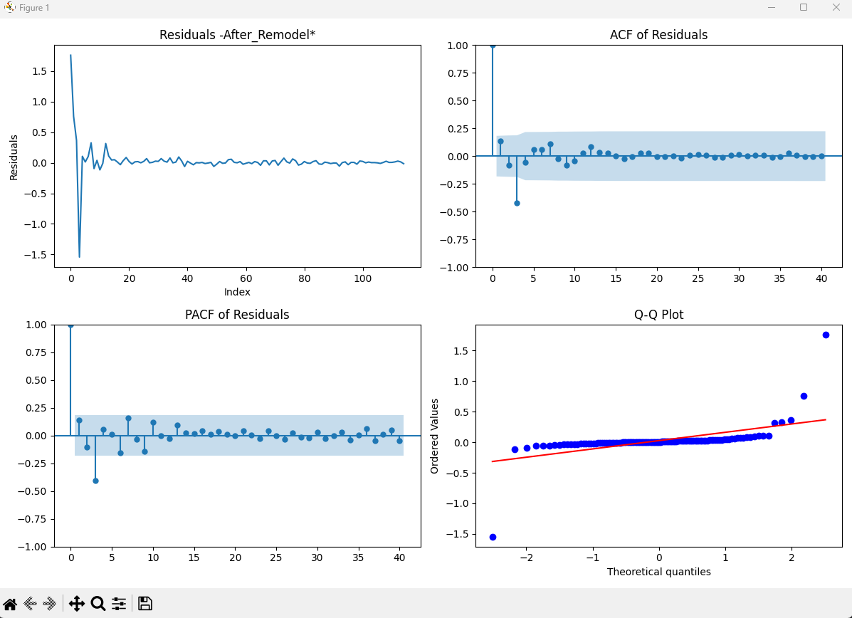
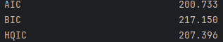
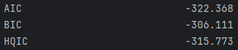
SARIMAx Analysis - Period: : Yearly

Slide 36
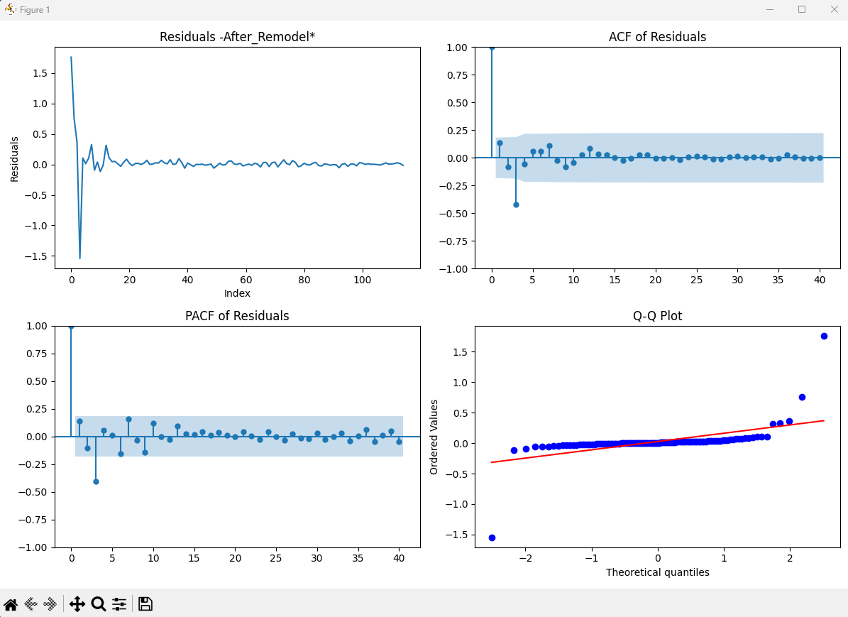
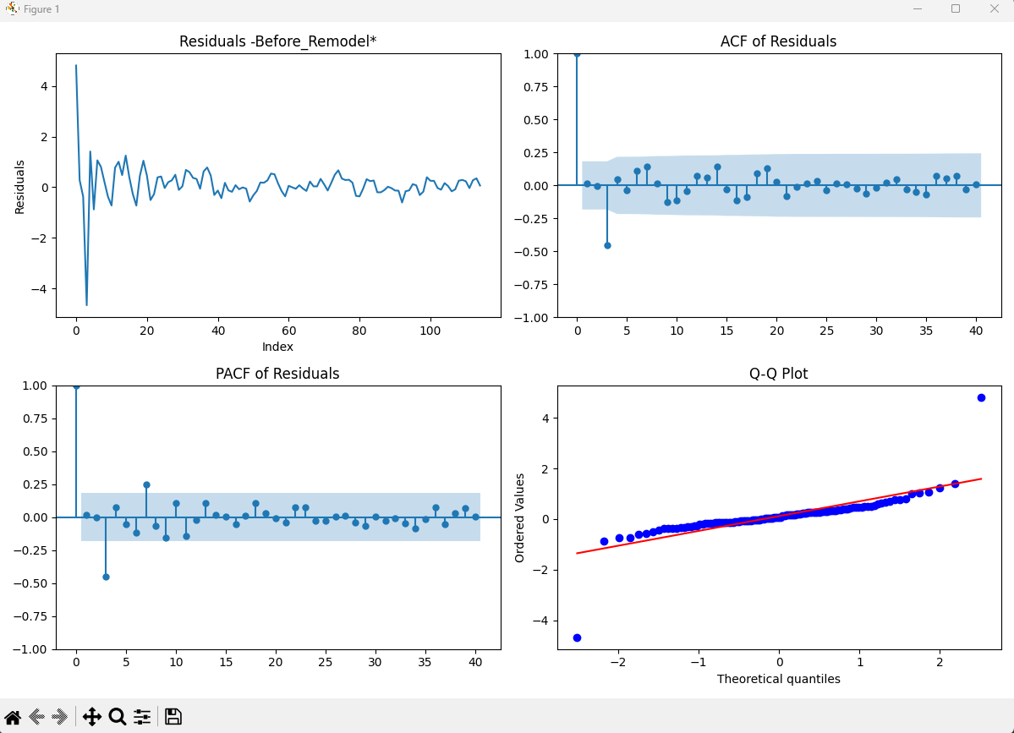
SARIMAx Analysis - Period: : Monthly

Slide 37
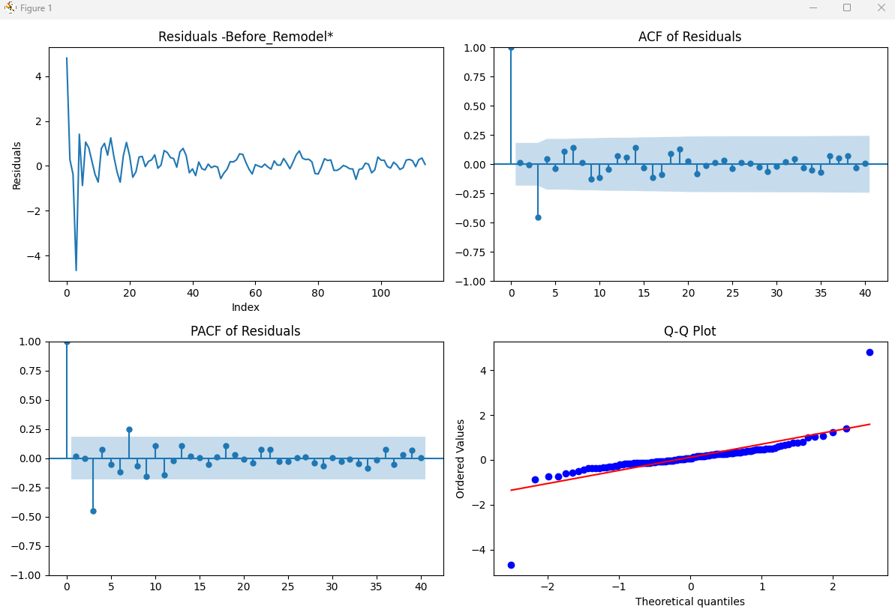
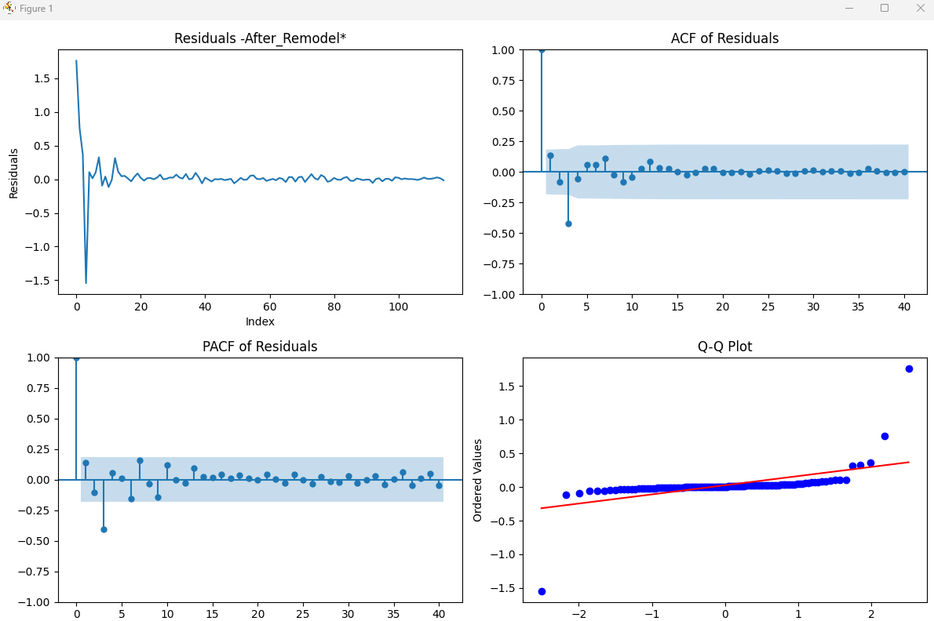
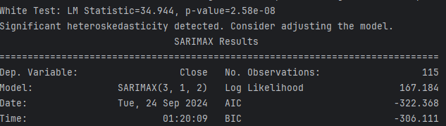
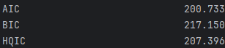
SARIMAx Analysis - Period: Daily

Slide 38
Summary

Slide 39
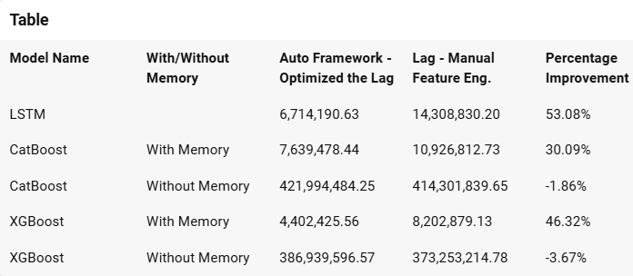
XGBoost TS Hybrid solution

Slide 40

THANK YOU

